Slide 1
welcome

Slide 2
Group members:
1- Nora Mohammed Abdellah 2- Mayar Atef Najib 3- Fatma Abdelhakem Mohamed 4- Ahmed Mohamed Abdulhamid 5- Elomda Sultan Abdelazize 6- Mohamed Mostafa Fathy 7- Abdallah Ahmed Hamdy

Slide 3

Presentation on

Slide 4
Introduction:
Purpose: • The purpose of E-Shop is to bring convenience for customers as they do not have to leave home and only need to browse website online, especially for buying the products which are not sold in nearby shops. • It could help customers buy wider range of products and save customer’s time.

Slide 5
Intended Audience and Reading Suggestions:
The different types of readers are : • Developers • Customers • Stakeholders

Slide 6
product scope:
• E-commerce or Electronic commerce is termed as selling and buying
behaviour of products and services over the internet.
• It is also referred to as the sales of different items on the marketplaces in which money transaction activity takes place

Slide 7
Reference:
• https://en.wikipedia.org/wiki • https://stackoverflow.com • https://www.w3schools.com • https://www.geeksforgeeks.org

Slide 8
Overall Description:
The E-shop system enables vendors to set up online shops, customers to browse through the shops, and a system administrator to approve and reject requests for new shops and maintain lists of shop categories. Also the developer is designing an online shopping site to manage the items in the shop and also help customers to purchase them online without visiting the shop physically.
The E-shop system will use the internet as the sole method for selling goods to its consumers

Slide 9
Product perspective:
This product aimed toward a person who don’t want to visit the shop as he might don’t get time for that or might not interested in visiting there and dealing with lot of formalities.

Slide 10
Product Functions:
Functions: A Customer can Browse category through the shops , choose products to place in a virtual shopping cart , remove item from virtual shopping cart ,pay cach or credit card The shopping cart details can be viewed and items can be removed from the cart. To proceed with the purchase, the customer is prompted to login and logout. Also, the customer can modify personal profile information (such as phone number and shipping address) stored by the application. The customer can also view the status of any previous orders and cancel any order that has not been shipped yet .
the customer can give feedbacks
A vistor can visit site and create New Account An Administrator can manage customer Database,view delete guest book entries Add/Remove/Update item category,approve/reject shop creation Request,shipping order

Slide 11
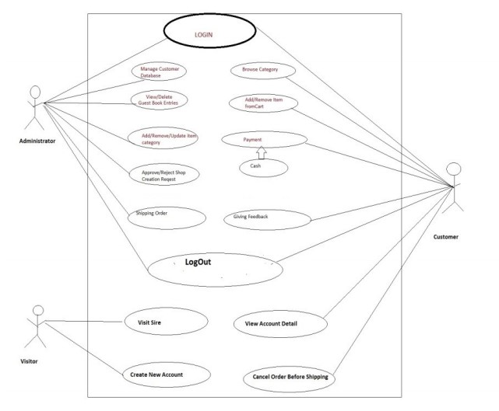

Slide 12
User classes and characteristics:
➢ The user should be familiar with the terms like login , register, order system etc.. ➢ The user should be familiar with the Internet. User Classes • Administrator • Customer • Visitor

Slide 13
User classes and characteristics:
Characteristics of User Classes 1-Administrator Administrators shall usually do anything related to application, in all pages. Administrator is responsible for updating and the maintenance of the web site content such as adding/removing/updating items. 2- Customer Customers are people who can use our website directly without login, to use the website people should have the basic computer using ability. 3- Vistors vistors can visit website and create New Account.

Slide 14
Design and Implementation Constraints:
System will need Any device can access internet using any browser, When designing interfaces of the system we had the capability to work with Software technologies: 1- Frontend technologies • HTML • CSS • JavaScript • Bootstrap

Slide 15
Design and Implementation Constraints:
for make implementation of UI and make the website able to response all devices, we will use JS framework to make more structural system 2- Backend technologies • JS platform like reactjs • php framework like laravel 3- Databases • MangoDB • Mysql

Slide 16
User Documentation:
The system will include user manual.
The user manual will include product overview,
complete configuration of the used software (such as SQL server)
technical details,
backup procedure and contact information which will include email address

Slide 17
Assumptions and Dependencies: The assumptions are:- 1) The coding should be error free. 2) The system should be user friendly so that it is easy to use for the users. 3) The system should have more capacity and provide fast access to the database. 4) The system should provide search facility and support quick transactions. 5) The system is running 24 hours a day. 6) Users may access from any computer that has internet browsing capabilities and an internet connection. 7) Users must have their correct usernames and passwords to enter into their online accounts and do actions.

Slide 18
Assumptions and Dependencies:
The dependencies are:- 1) The specific hardware and software due to which the product will be run. 2) On the basis of listing requirements and specification the project will be develop and run. 3) The end users (admin ) should have proper understanding to the product. 4) The information of all users must be stored in a database that is accessible by the system. .

Slide 19
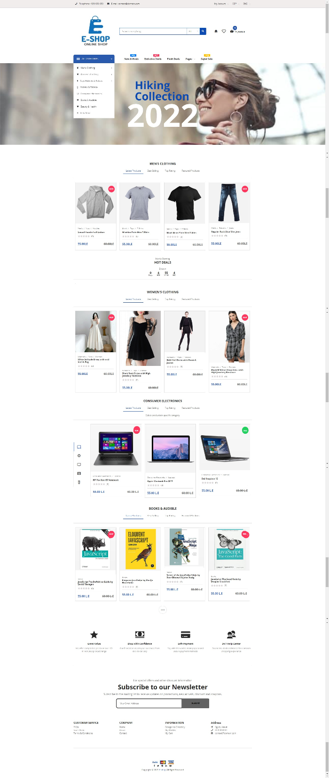
Home Page

Slide 20
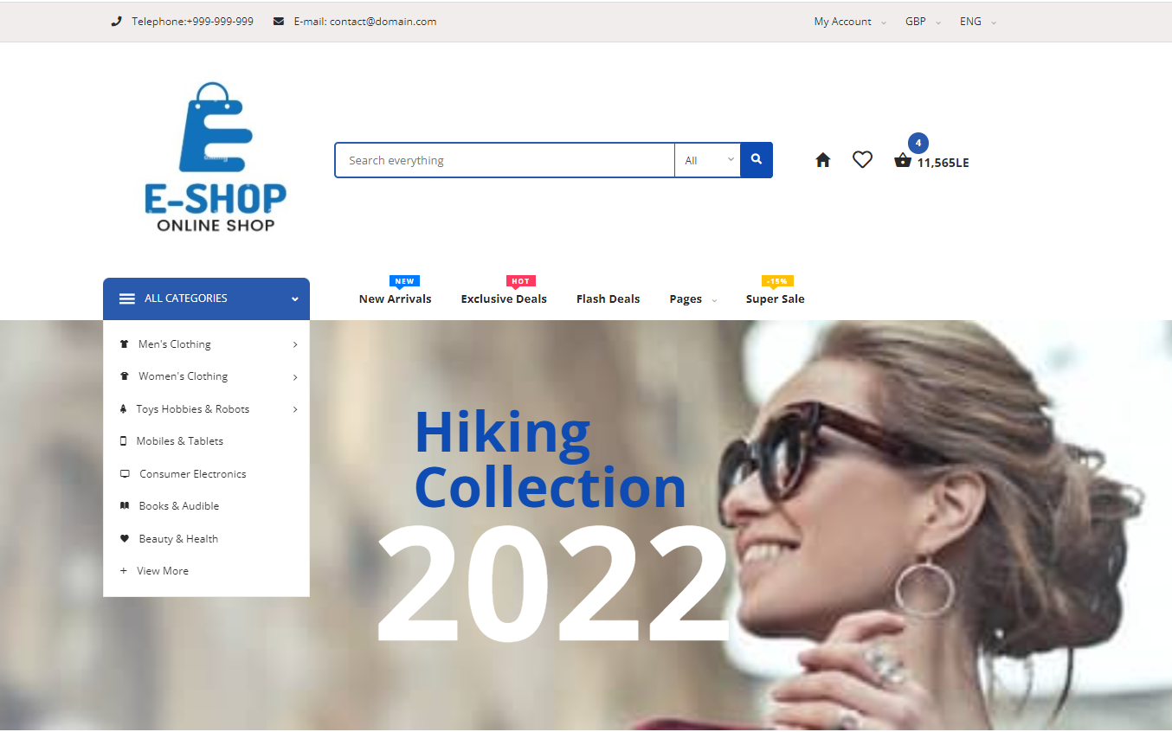
Home Page: Header

Slide 21
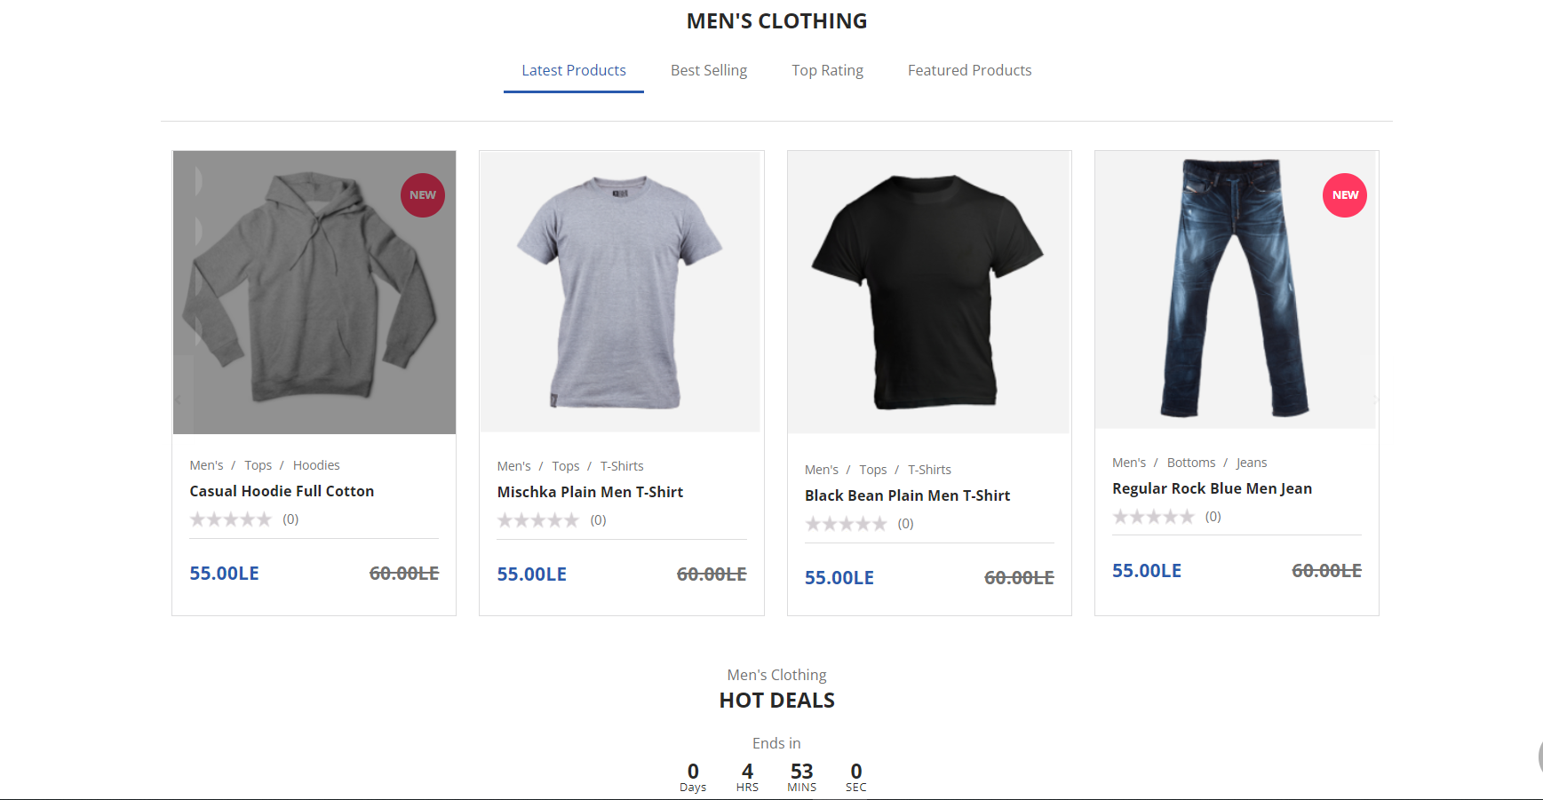
Home Page Men’s clothing category

Slide 22
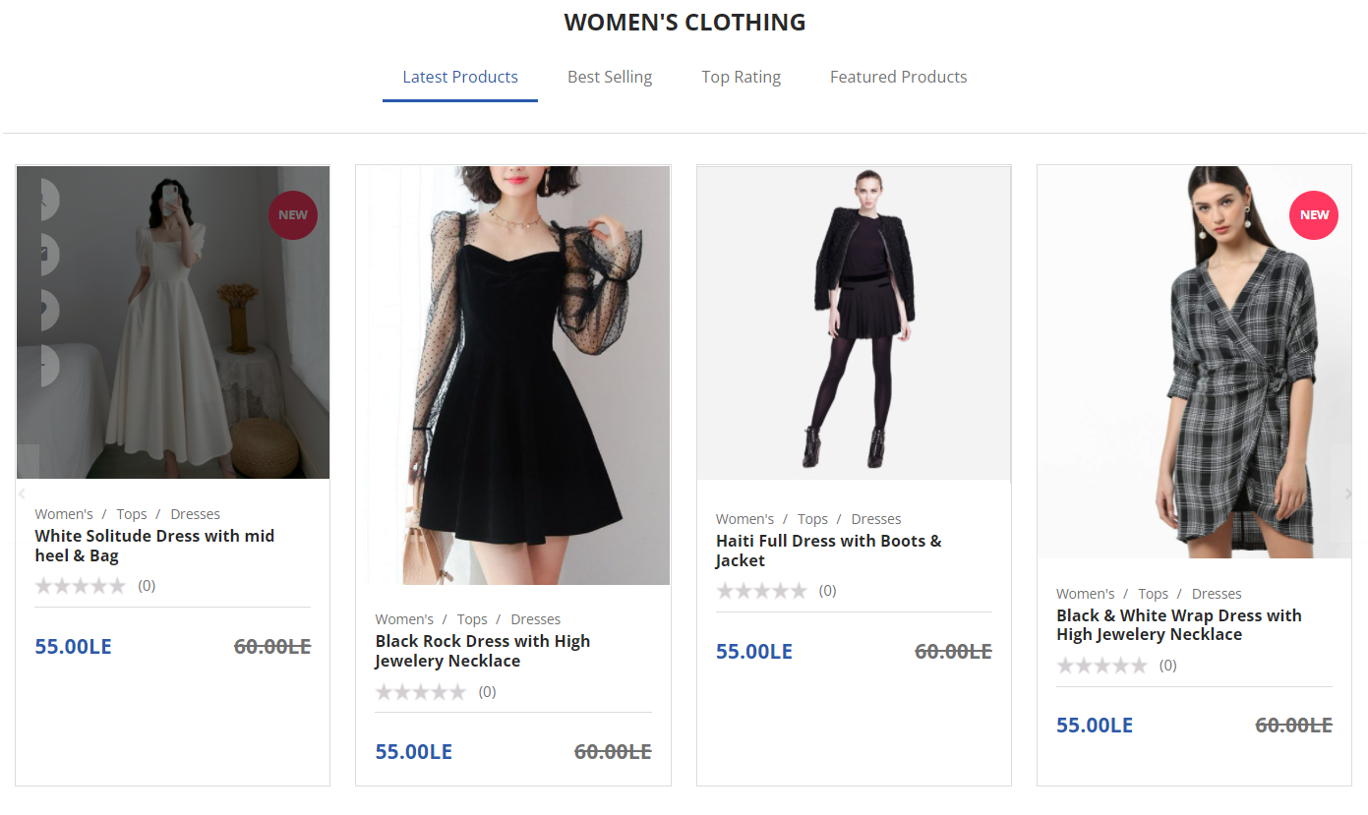
Home Page: Women’s clothing category

Slide 23
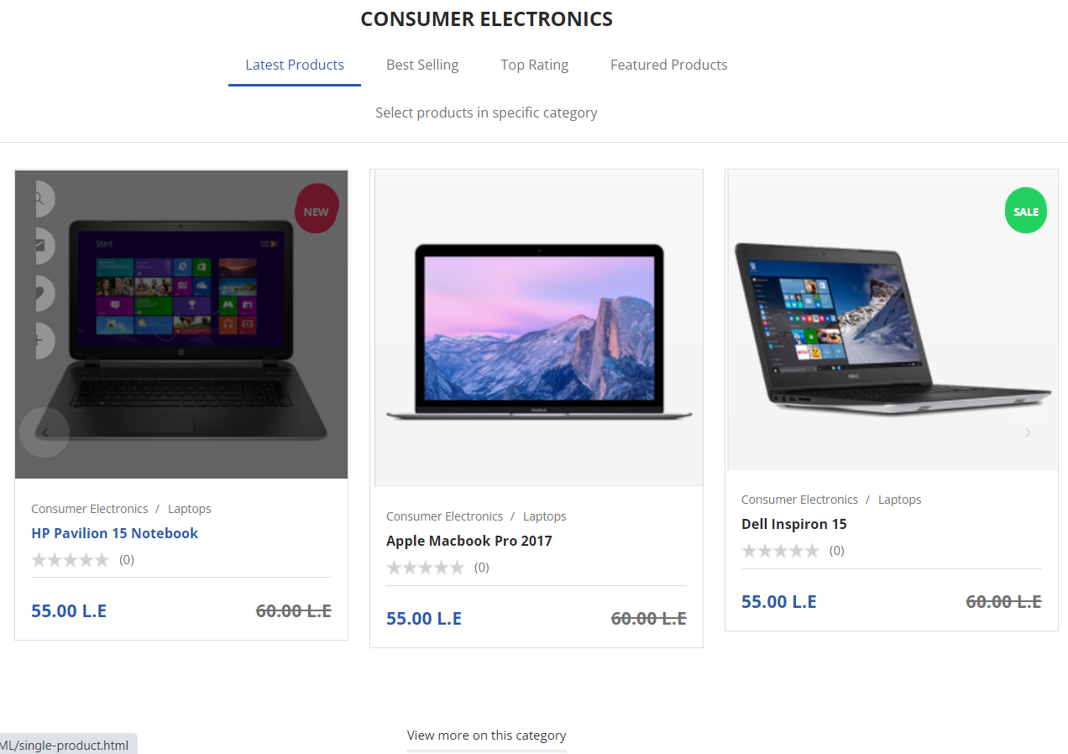
Home page: Consumer Electronics

Slide 24
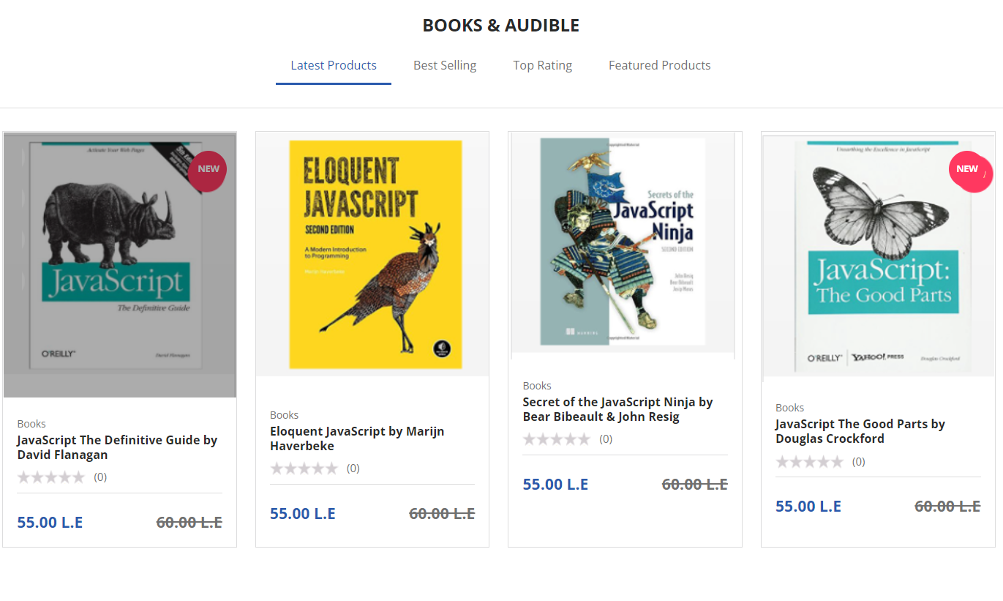
Home page: Books &Audible

Slide 25
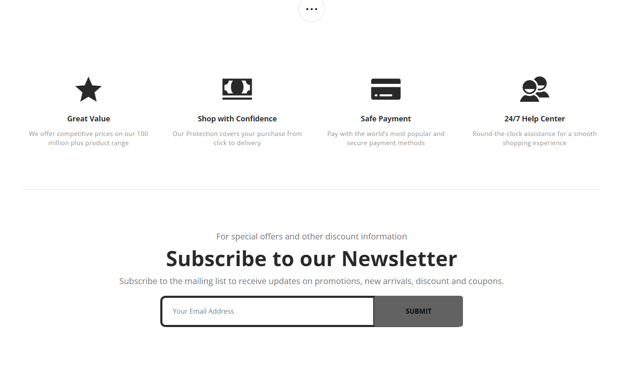
Home page: Footer

Slide 26
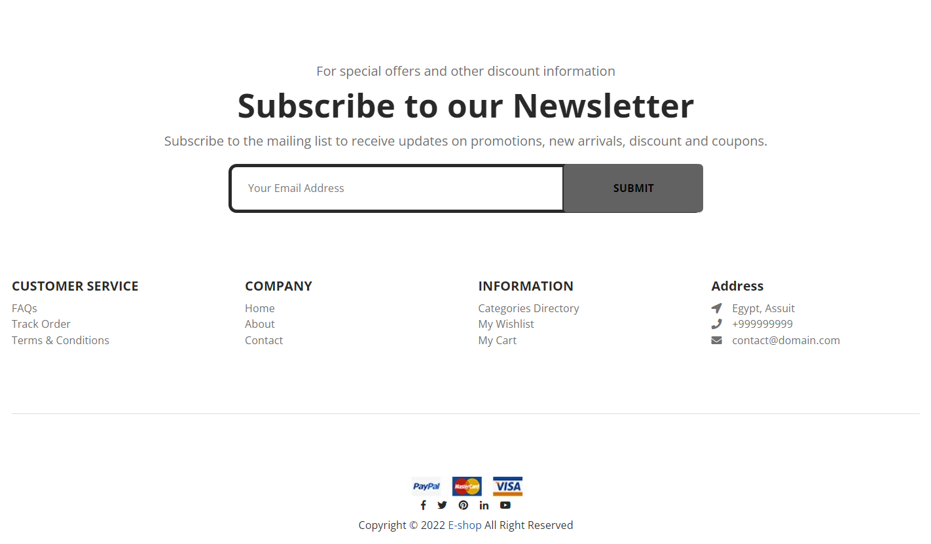
Home page: Footer:

Slide 27
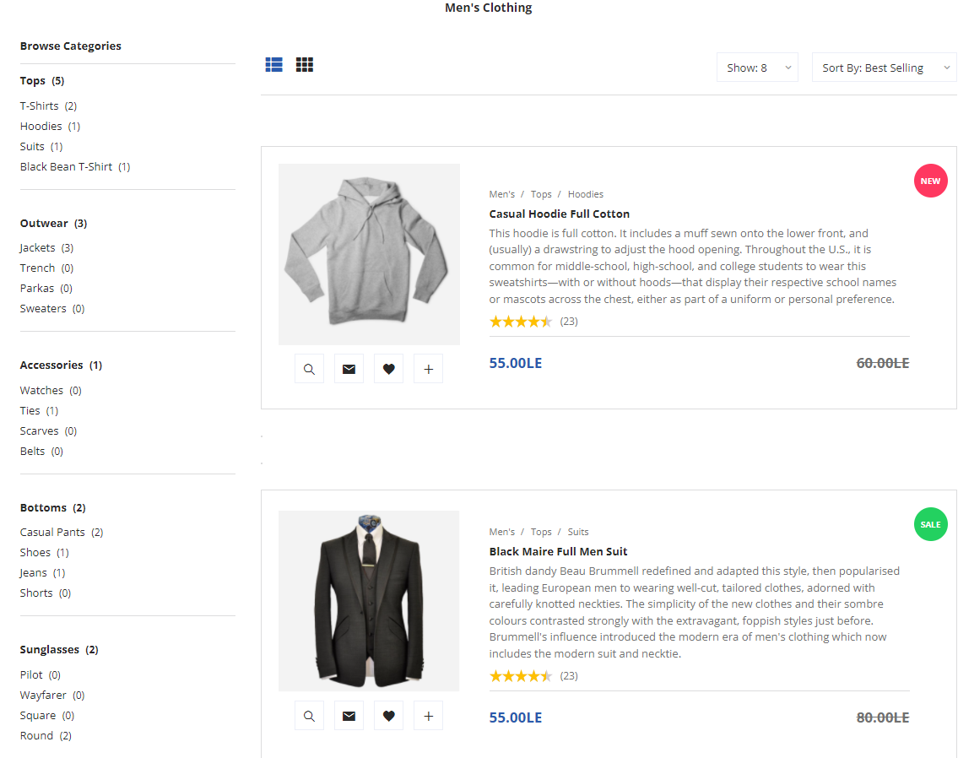
Category page

Slide 28
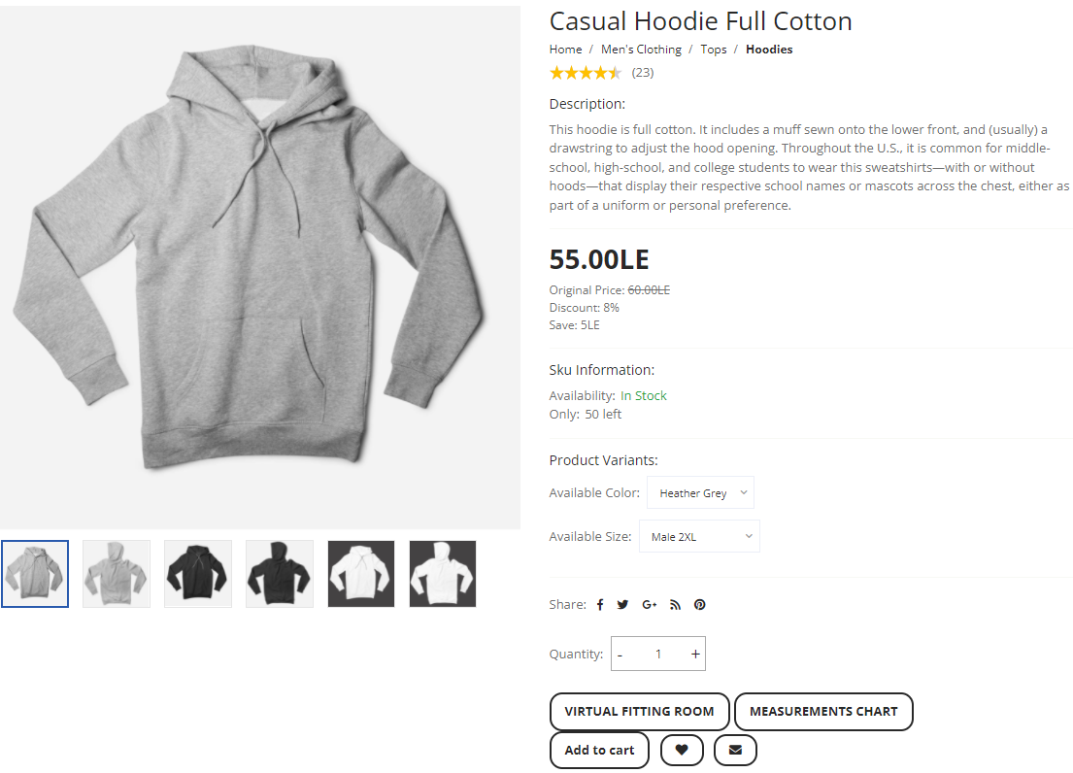
Product Page

Slide 29
Virtual fitting room

Slide 30
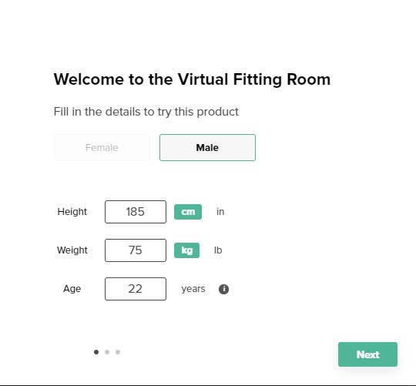
Step1: .choose the gender(if female or male) .enter your height in cm . .enter your weight in Kg . .enter your age . Why enter the age ?...... Because The body shape changes over the years and this affects our calculation.

Slide 31
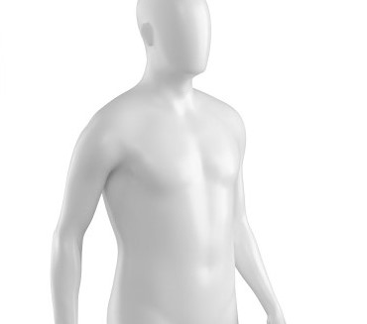
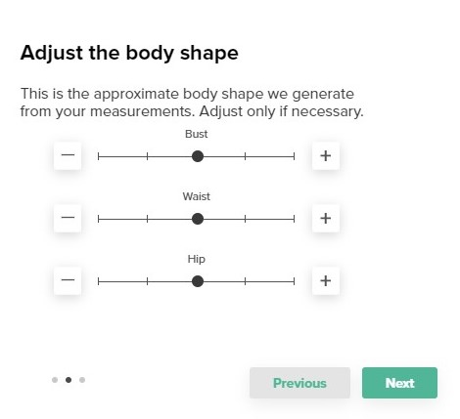
Step2:
.Adjust the body shape
.This body shape generated from your measurements
you can modify the body shape by:
.change the chest or west measurements .

Slide 32
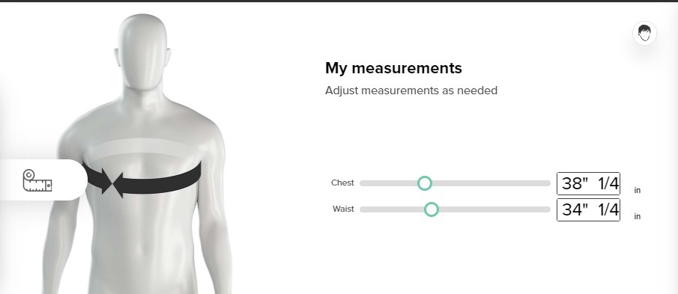
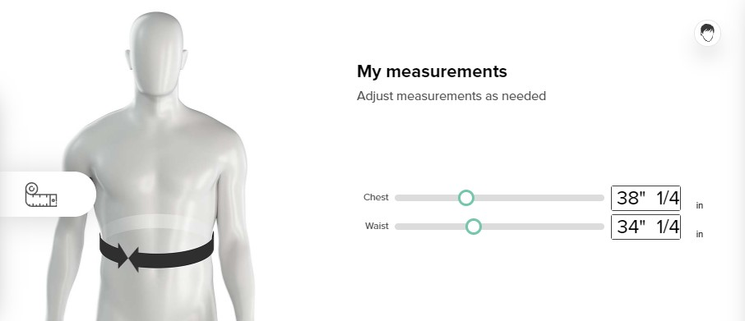
Step3:
Through the changes that occurred in the Step 2
finally…. .This is the final calculation .you can change the measurements if you need

Slide 33
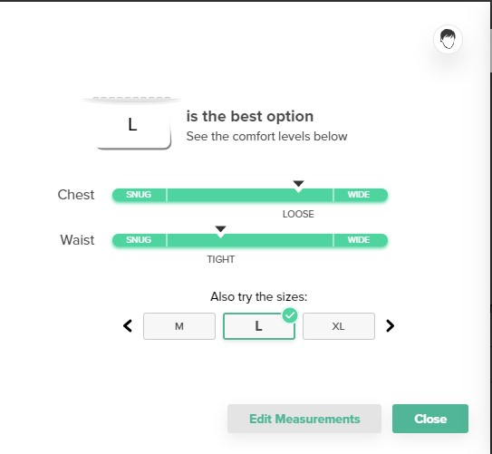
Step4:
through this step we recommended for you the best option

Slide 34
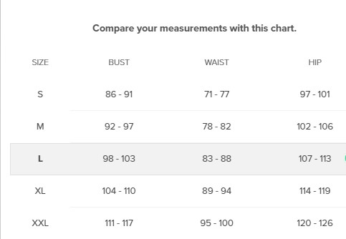
Measurements chart:

Slide 35
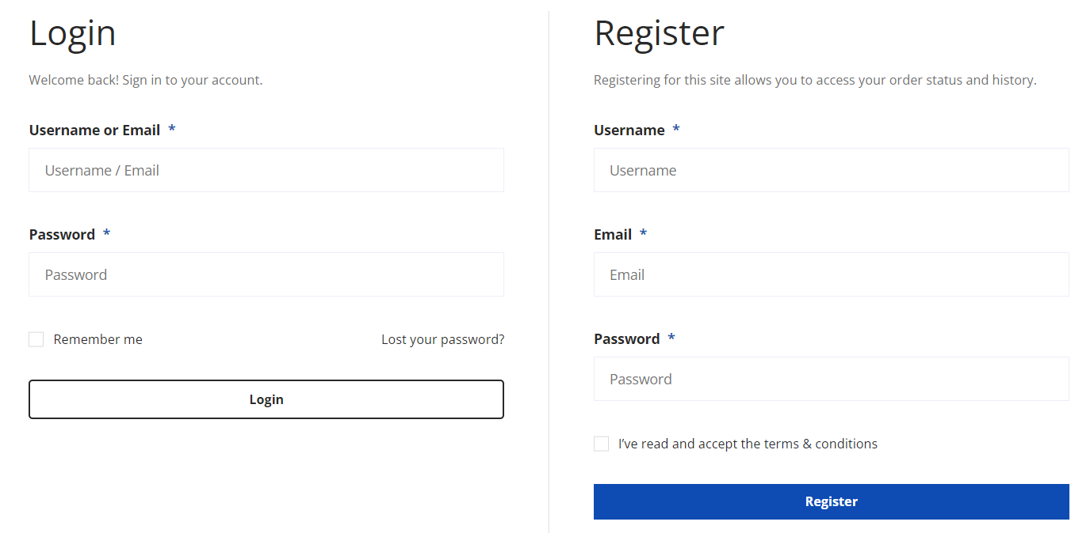
Login and Register page

Slide 36
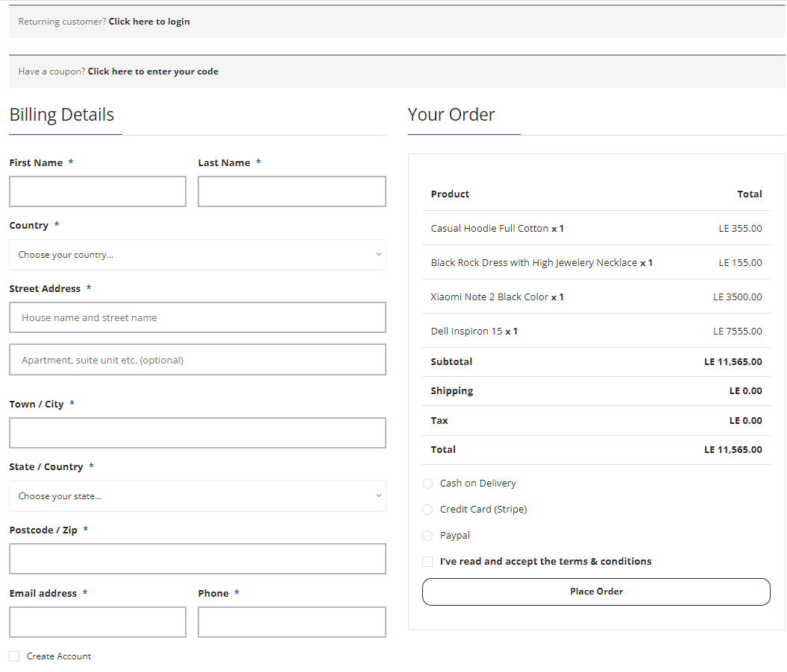
Checkout Page

Slide 37
System Features Home, Header & Footer Features List - Top level domain with HTTPs - Business logo - User-friendly navigation - Wishlist - Customer login - Store finder - Shopping cart - Search bar - Shopping cart - Featured products or Bestselling products - Text content - FAQ, returns and exchanges, store locator, shipping information, order tracking etc. - Contact us - Newsletter signup

Slide 38
System Features - Payment system icons - Social Media links - Link to about pages - Terms and Conditions, Privacy Policy, Sitemap Product Category Page Features List - Consistent image size - Breadcrumb navigation - Show the number of products displaying in the page - Product filtering and sorting - Page description field Product Page Features List - Product title - Good quality of images with zoom in functionality - Pricing information with potential sales or discounts

Slide 39
System Features - A field to change purchase quantities - Product variables (if necessary) - Add to cart button - Trust signal around “Add to Cart” button - Add to Wish List and Compare button on each product page - Social share buttons for each ecommerce product - Product description - Consumer reviews on products - Related products Customer Checkout, Shopping Cart and Wishlist - Accept all payment methods - Cart details - Final price - Shipping method (offer low shipping cost) - Billing address and shipping address - Security seals - Include an area to punch in promo codes - Have an option to change the quantity or remove items

Slide 40
System Features Back-end Features List - Dashboard/reporting tools - Administrator management - Customer management - Store management - Content management - Order and shipping management - Payment, taxes and location management - SEO management - Email marketing integration - Discount and promotion management - Root file upload - Tracking code integration - Responsive design - Browser compatibility - Fast loading - For digital downloads, explain how they receive products - Multilevel security - Automatic site backup

Slide 41
Other Nonfunctional Requirements Performance Requirements 1- The website’s homepage should load in less than 4 seconds on iOS 10+, Safari on 4G. 2- Our system work on real time data Safety Requirements Not Applicable Security Requirement 1- Only the system data administrator can assign roles and change access permissions to the system. 2- The website must be resilient to any kind of attacks, including DDoS and XSS attacks. 3- Using secure web protocols 4- Use secure payment using security system of bank

Slide 42
Other Nonfunctional Requirements Software Quality Attributes 1- Maintainability: Because we are looking to grow, the website shall remove all the back-end complexities for in-house engineers to make changes to the system in the future. 2- Scalability : Our main goal for the next two years is internationalization, so the website shall have multiple storeviews for each country we’re selling to 3- Usability 4- Flexibility

Slide 43
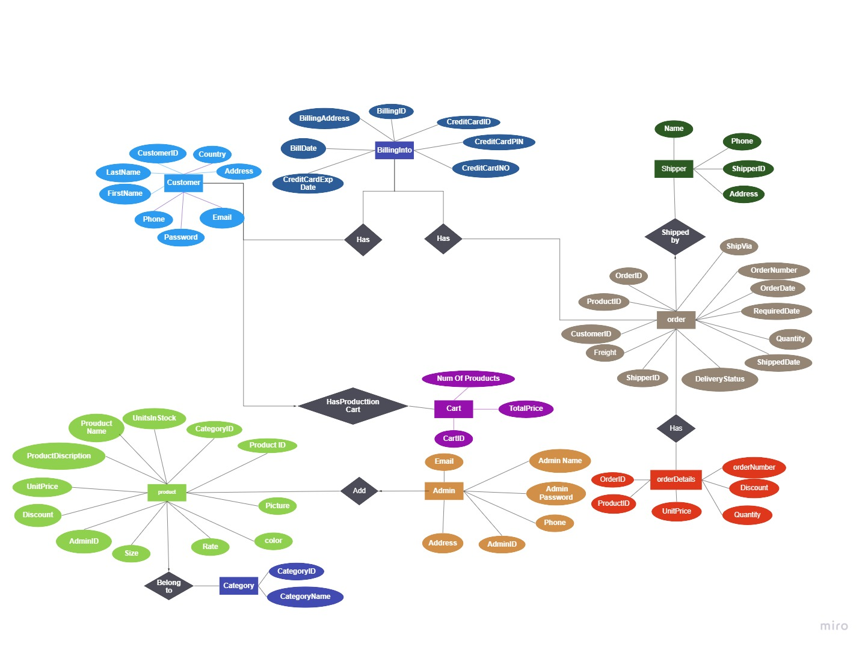

Slide 44
Thank you

